Slide 1

Apache Kafka
A distributed publish-subscribe messaging system
Neha Narkhede, LinkedIn nnarkhede@linkedin.com, 11/11/11

Slide 2
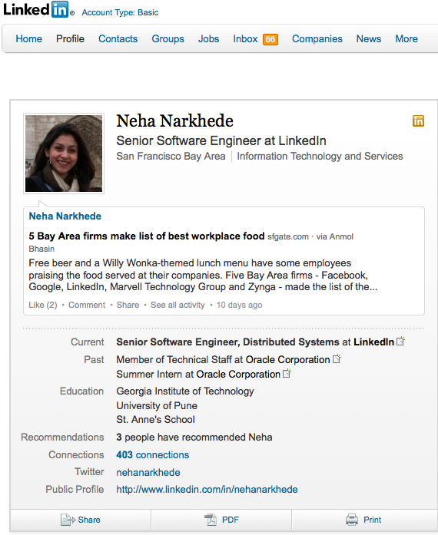

Slide 3
Outline
Introduction to pub-sub
Kafka at LinkedIn
Hadoop and Kafka
Design
Performance

Slide 4
What is pub sub ?
Producer
publish(topic, msg)
Consumer
subscribe
Topic 1
Topic 2
msg
Topic 3
Publish subscribe
system
Consumer
Producer
msg
Notes:
Multiple subscribers, decoupling
Some examples : email notification on adding connection etc

Slide 5
Outline
Introduction to pub-sub
Kafka at LinkedIn
Hadoop and Kafka
Design
Performance

Slide 6
Motivation
Activity tracking
Operational metrics

Slide 7
Kafka
Distributed
Persistent
High throughput

Slide 8
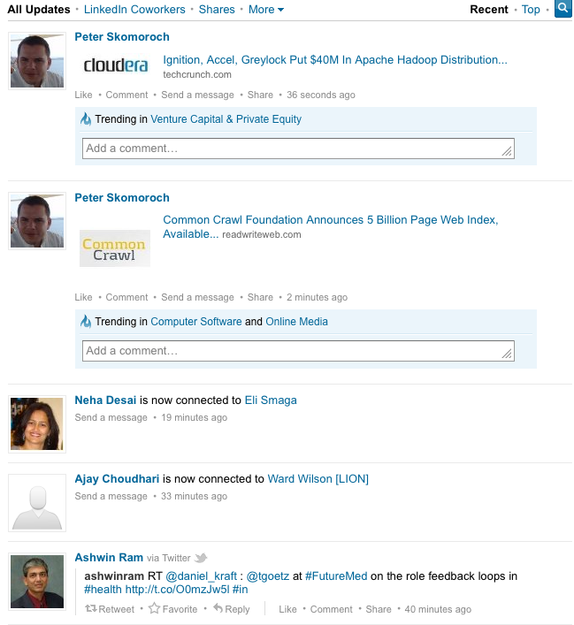
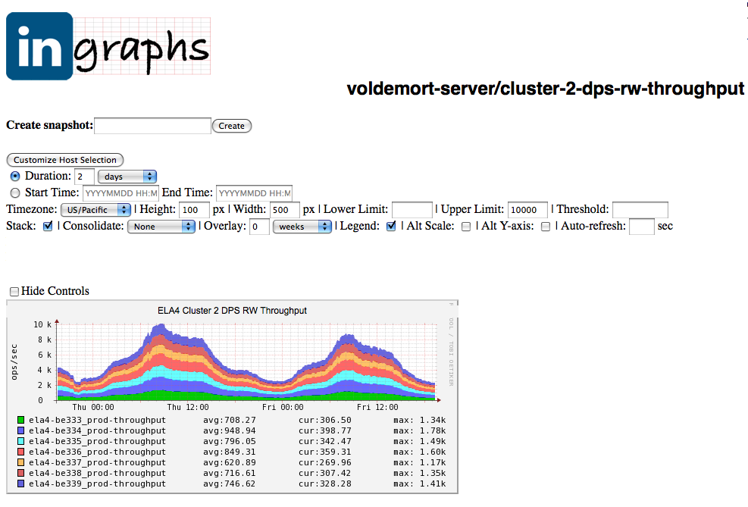
Kafka at LinkedIn
Frontend
Frontend
Service
Service
Broker
Broker
Broker
Kafka
Real time monitoring
Security
systems
News feed
Hadoop
DWH
Notes:
Every service in LinkedIn uses Kafka. 10-15 of real time consumers using Kafka

Slide 9
Outline
Introduction to pub-sub
Kafka at LinkedIn
Hadoop and Kafka
Design
Performance

Slide 10
Hadoop Data Load for Kafka
Live data center
Offline data center
Hadoop
Hadoop
Dev Hadoop
Frontend
Kafka
Kafka
Frontend
Kafka
Kafka
Real time consumers
Kafka
Kafka
Hadoop
Hadoop
PROD Hadoop
Notes:
Give some background on – basically generating business reports
Tracking data is crucial to measure user engagement – unique member visits per day, ad metrics CTR to ad publishers
Also data analytics – new models for PYMK
Collapse multple boxes into one. Show multiple Hadoop clusters
If you track some new data, it will automatically reach Hadoop in a few minutes.

Slide 11
Multi DC data deployments
Live data centers
Offline data centers
Real time consumers
Kafka
Hadoop
Real time consumers
Hadoop
Real time consumers
Hadoop
Hadoop
Real time consumers
Kafka
Hadoop
Real time consumers
Hadoop
Real time consumers
Hadoop
DWH

Slide 12

Volume
20B events/day
3 terabytes/day
150K events/sec

Slide 13
Message queues
ActiveMQ
TIBCO
Log aggregators
Flume
Scribe
KAFKA
Low throughput
Secondary indexes
Tuned for low latency
Focus on HDFS
Push model
No rewindable consumption
Notes:
Messaging systems tuned for very low latency, but not high volume

Slide 14
What Kafka offers
Very high performance
Elastically scalable
Low operational overhead
Durable, highly available (coming soon)

Slide 15
Architecture
Producer
Producer
Broker
Broker
ZK
Broker
Broker
Consumer
Consumer

Slide 16
Outline
Introduction to pub-sub
Kafka at LinkedIn
Hadoop and Kafka
Design
Performance

Slide 17
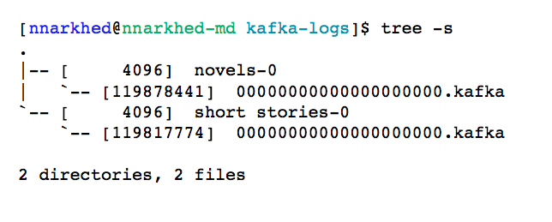
Efficiency #1: simple storage
Each topic has an ever-growing log
A log == a list of files
A message is addressed by a log offset
Notes:
One topic is enough

Slide 18
Efficiency #2: careful transfer
Batch send and receive
No message caching in JVM
Rely on file system buffering
Zero-copy transfer: file -> socket

Slide 19
Multi subscribers
1 file system operation per request
Consumption is cheap
SLA based message retention
Rewindable consumption

Slide 20
Guarantees
Data integrity checks
At least once delivery
In order delivery, per partition

Slide 21
Automatic load balancing
Producer
Producer
Broker
Broker
Consumer
Consumer

Slide 22
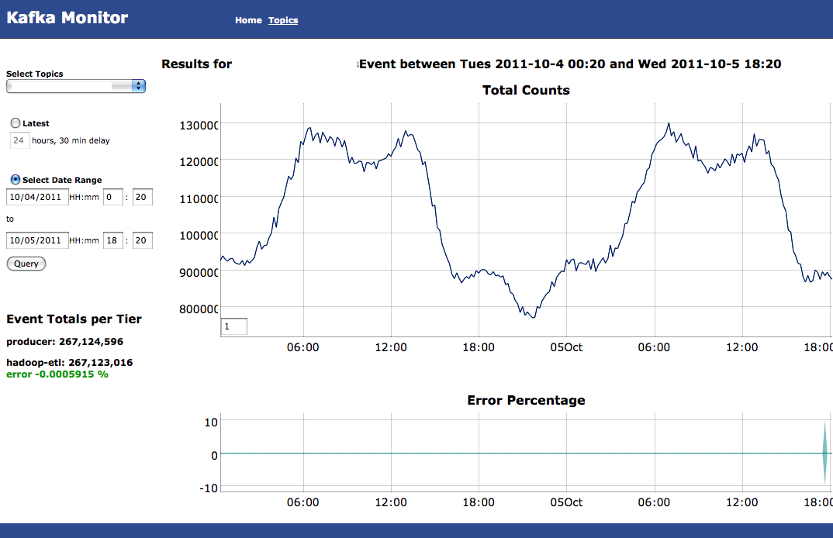
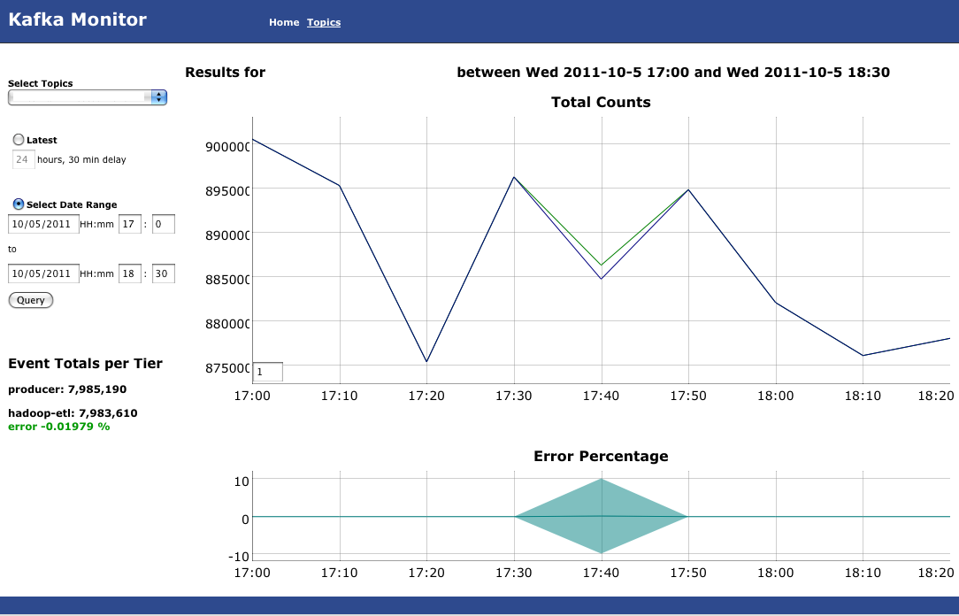
Auditing
# events published = # events consumed

Slide 23
Outline
Introduction to pub-sub
Kafka at LinkedIn
Hadoop and Kafka
Design
Performance

Slide 24
Performance
2 Linux boxes
16 2.0 GHz cores
6 7200 rpm SATA drive RAID 10
24GB memory
1Gb network link
200 byte messages
Producer batch size 200 messages

Slide 25
Basic performance metrics
Producer batch size = 40K
Consumer batch size = 1MB
100 topics, broker flush interval = 100K
Producer throughput = 90 MB/sec
Consumer throughput = 60 MB/sec
Consumer latency = 220 ms
Notes:
s

Slide 26
Latency vs throughput
(100 topics, 1 producer, 1 broker)

Slide 27
Scalability
(10 topics, broker flush interval 100K)

Slide 28
Throughput vs Unconsumed data
Notes:
Add compression line here instead

Slide 29
State of the system
4 clusters per colo, 4 servers each
850 socket connections per server
20 TB
430 topics
Batched frontend to offline datacenter latency => 6-10 secs
Frontend to Hadoop latency => 5 min
Notes:
Batching on frontends, batching on both kafka clusters, tuned for throughput

Slide 30
State of the system
Successfully deployed in production at LinkedIn and other startups
Apache incubator inclusion
0.7 Release
Compression
Cluster mirroring

Slide 31

Replication

Slide 32
Some project ideas
Security
Long poll
More compression codecs
Locality of consumption

Slide 33
Team
Jay Kreps
Jun Rao
Neha Narkhede
Joel Koshy
Chris Burroughs

Slide 34
Thank you
http://incubator.apache.org/kafka/index.html
kafka-users@incubator.apache.org
http://www.linkedin.com/in/nehanarkhede
@nehanarkhede
#kafka
Notes:
Kafka webpage here

Slide 35
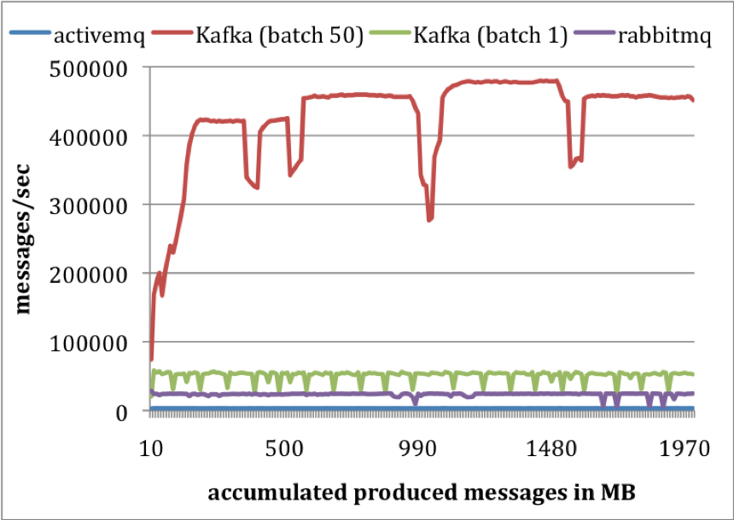
Notes:
single producer to send 10 million messages, 200 bytes each.
single consumer thread
Flush interval 10K
ActiveMQ – syncOnWrite=false, KahaDB
RabbitMQ – mandatory=true, immediate=false, file persistence
the producer throughput in messages/secondKafka produces at the rate of 50K / second with batch size of 1
400K / second with batch size of 50.
These numbers are orders of magnitude higher than that of ActiveMQ and at least twice better than RabbitMQ.
No producer ACKS
more compact storage format
9 bytes/message overhead in Kafka
144 bytes/message overhead in ActiveMQ
Cost of maintaining heavy index structures
One thread in ActiveMQ spent most of its time accessing a B-Tree to maintain message metadata and state

Slide 36
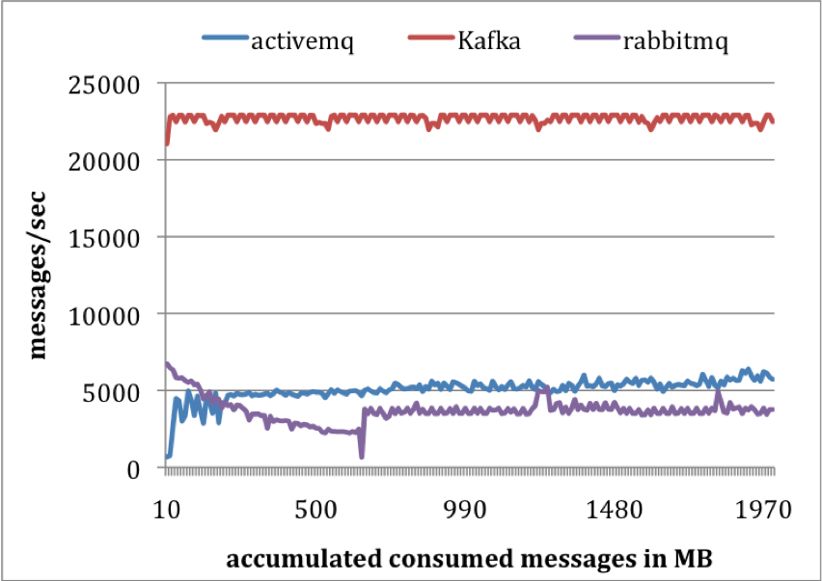
Notes:
Kafka consumes at 22K messages / sec, more than 4 times that of ActiveMQ and RabbitMQ
More efficient storage format - fewer bytes transferred from server to consumer
The broker in ActiveMQ/RabbitMQ had to maintain delivery status for each message. One of the threads in ActiveMQ kept writing KahaDB pages to disk during the test.
Kafka uses sendFile API to reduce the transmission overhead

Slide 37
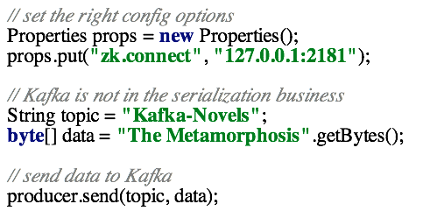
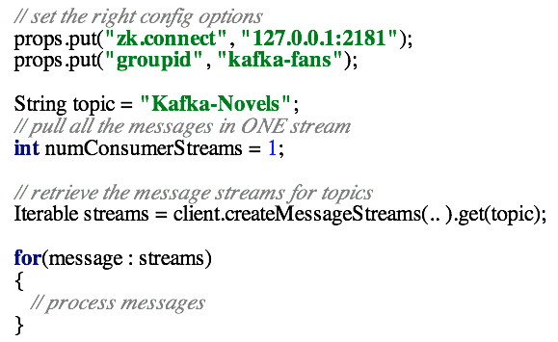
API

